Slide 1


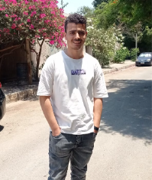


Developers of Wazz Up!!! :
Ashraf Khaled Gabr
Abdelrahman Sayed
Abdelrahman Atef Hassan Haggag
Yasmin Mohamed Awwad
ashrafkhaled200514@gmail.com
abdelrahmansayed472004@gmail.com
abdelrahmanhaggag414@gmail.com
yasminmohamedawwad@gmail.com
01503467758
01024769311
01020658532
01017830522
Ahmed Sameh Mohamed Zain
ahmedsameh2465@gmail.com
01030395062

Slide 2

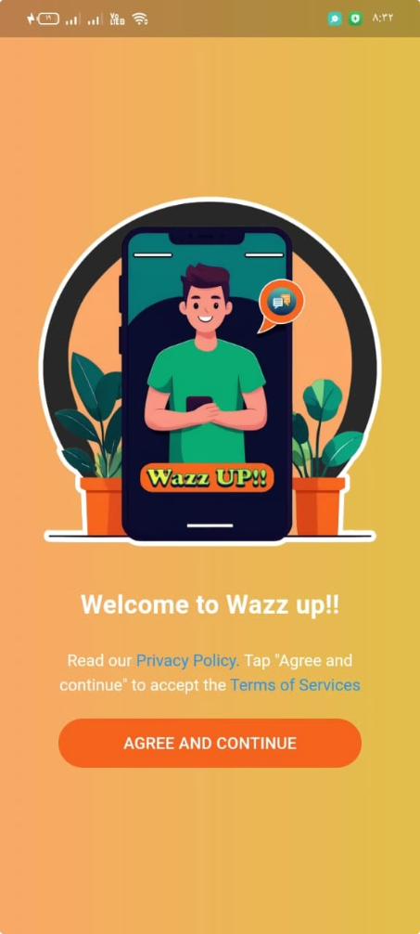
Wazz up!! :
Elevating Messaging Experiences
Unlock the future of seamless communication with our innovative WhatsApp clone. Designed to enhance your messaging experience, this powerful app brings you the latest features for staying connected with friends, family, and colleagues.

Slide 3

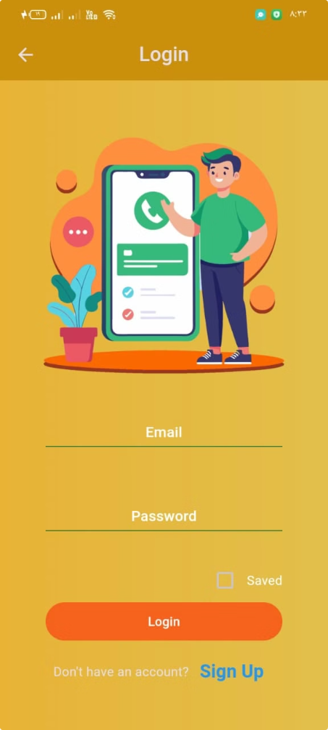
Login Screen
The user-friendly login screen allows users to securely enter their email and password.
Ensures seamless access to the app with input validation for error-free login.
Includes options like “Forgot Password” for password recovery and "Sign Up" for new users.

Slide 4
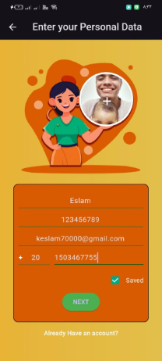
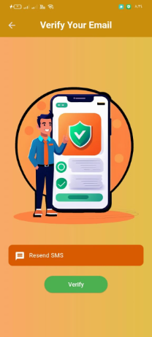
Authentication with Gmail & Verification
Sign Up Screen
Verification Screen
Secure Login
Phone Number Verification
Hassle-free Access
Streamline the sign-in process by integrating Gmail authentication, ensuring a seamless and secure experience for your users.
Implement a robust verification system using users' phone numbers to validate their identities, adding an extra layer of security.
Provide your users with a convenient and frictionless way to log in, allowing them to focus on their messaging needs.
Enhanced Privacy
Protect user data by ensuring robust authentication and verification processes, giving your users peace of mind.

Slide 5
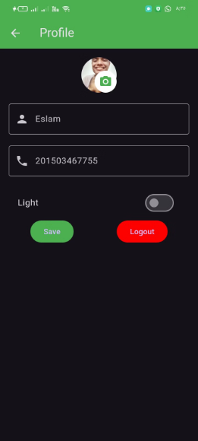
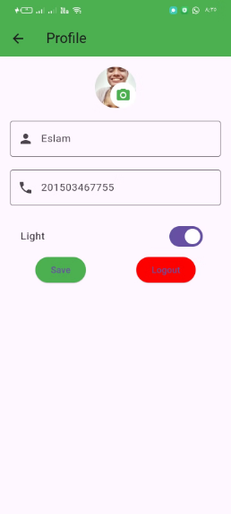
Light and Dark Mode for Enhanced Accessibility
Dark Mode
Light Mode
Optimized for low-light settings, offering a sleek, modern look while saving battery life on OLED screens and improving readability at night.
and clear design, ideal for daylight or well-lit environments, reducing eye strain during the day.

Slide 6

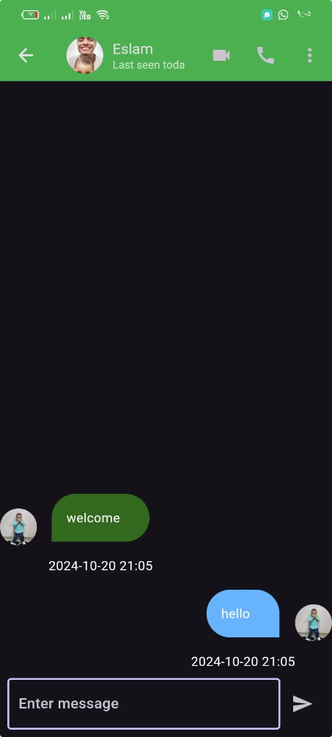
Chat Functionality with Others
One-on-One Chats
Facilitate private conversations between individual users, enabling them to share messages, files, and multimedia content securely.
Group Chats
Allow users to create and participate in group conversations, fostering collaboration and the exchange of ideas among multiple participants.

Slide 7

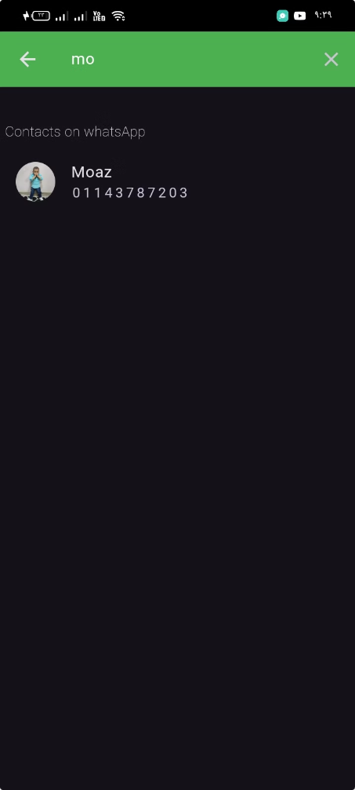
Powerful Search for Users by Name or Phone Number
1
Intuitive Search
2
Comprehensive Results
Implement a user-friendly search functionality that allows users to find their contacts by name or phone number, facilitating efficient communication.
Ensure that the search feature provides accurate and comprehensive results, enabling users to quickly connect with the desired contacts.
3
Seamless Integration
Seamlessly integrate the search functionality into the app's overall interface, ensuring a smooth and intuitive user experience.

Slide 8
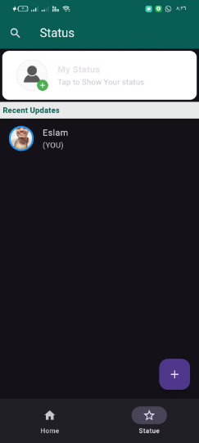
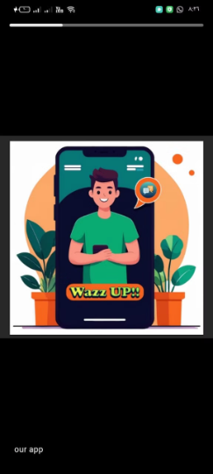



Innovative Status Updates with Auto-Delete in 24 Hours
Temporary Status
Personalized Expression
Visible to Connections
Allow users to share ephemeral status updates that automatically disappear after a 24-hour period, fostering a sense of immediacy and exclusivity.
Empower users to express themselves through customizable status updates, reflecting their mood, activities, or any other relevant information.
Ensure that status updates are visible to the user's contacts, enabling them to stay informed about each other's activities and availability.

Slide 9

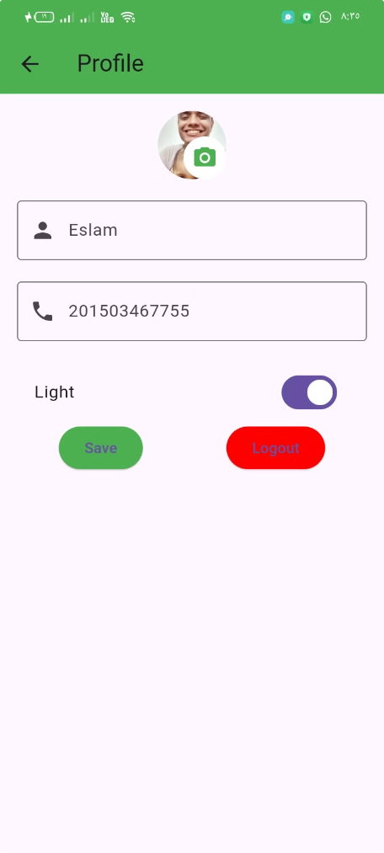
Personalized User Data Management
Profile Customization
Data Privacy
Allow users to personalize their profiles by updating information such as their name, profile picture, and bio, enabling them to express their individuality.
Empower users to control their privacy settings, granting them the ability to manage who can view their personal information and contact details.
Notification Preferences
Account Management
Enable users to customize their notification preferences, ensuring they receive alerts and updates tailored to their preferences.
Provide users with the ability to manage their account settings, including the option to deactivate or delete their account if desired.

Slide 10




Secure and Private Messaging
End-to-End Encryption
Secure Storage
Privacy Policies
Implement robust end-to-end encryption to ensure that all messages and data exchanged within the app are protected from unauthorized access.
Securely store user data and messages, minimizing the risk of data breaches and safeguarding the privacy of your users.
Develop transparent and comprehensive privacy policies to inform users about how their data is collected, used, and protected.

Slide 11
Intuitive User Interface for Optimal Experience
Clean Design
Responsive Layout
Accessibility Features
Implement a sleek and visually appealing user interface that is intuitive and easy to navigate, enhancing the overall user experience.
Ensure that the app's layout and features adapt seamlessly to various screen sizes and device orientations, providing a consistent experience across platforms.
Incorporate accessibility features, such as support for screen readers and high-contrast modes, to cater to users with diverse needs and abilities.

Slide 12

Conclusion: The Future of Messaging Apps
Our WhatsApp clone represents a significant step forward in the world of messaging apps, blending cutting-edge technology with an unparalleled user experience. By continuously innovating and adapting to the evolving needs of modern users, we are poised to shape the future of seamless communication and connectivity.

